Slide 1
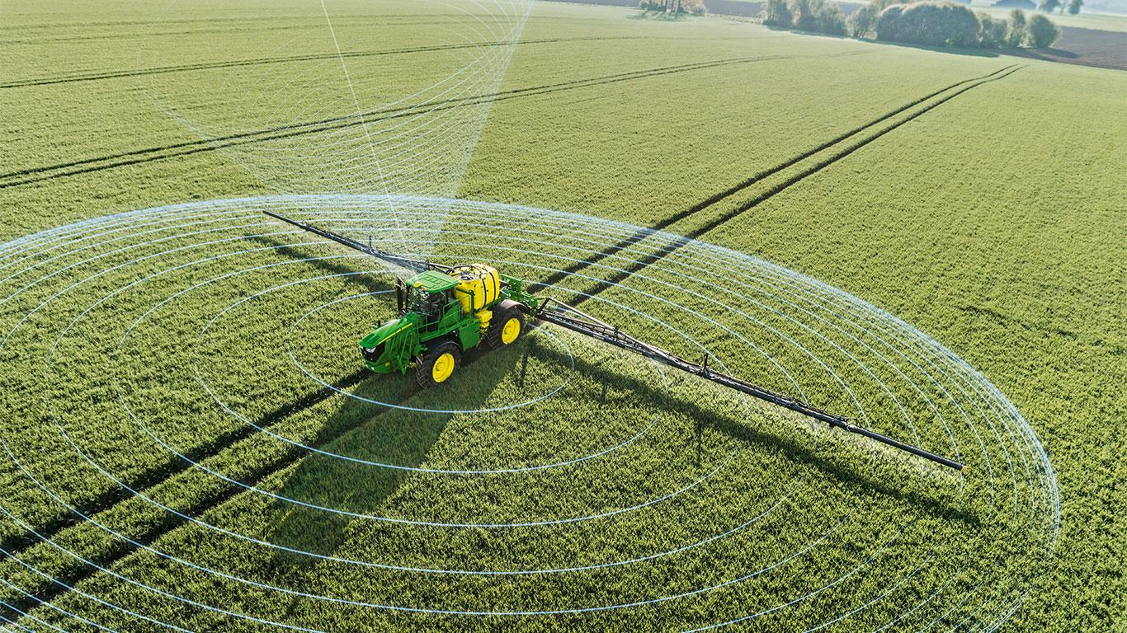
StripeFarmer
Software Engineering Project (SEP) Final presentation
Members of SEP Group 1
K.K.J. Burgers
M. Ghanem
A.N. Groote Woortmann
M.J.B. Keizer
B. van Leeuwen
W.J.A. van Santvoort
H.P.A. Swinkels
L. van de Beek
L.A. Roozen
SEP Group 1
Notes:
Léon

Slide 2

Contents:
Context: Precision Agriculture
What is Precision Agriculture?
Why is it important?
The problem
Our Goals
Our solution
Architecture
Demo
Notes:
Luuk

Slide 3
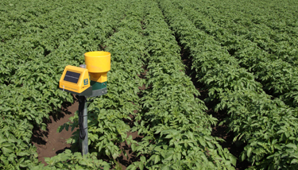
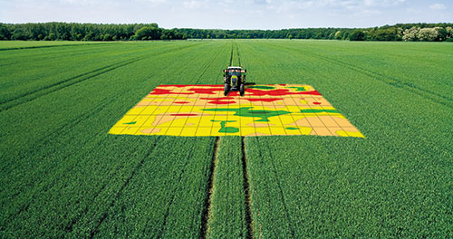
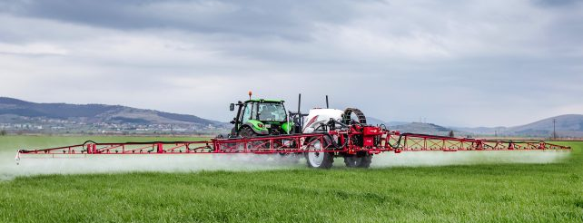
Context: Precision Agriculture
What is precision agriculture?
Collecting data with sensors
Monitoring the data
Exact watering and fertilizing
Notes:
Léon

Slide 4



Context: Precision Agriculture
Why is it important?
Global Food supply
Higher yield
Battle diseases
Farms get too big
Eco friendly
Cost savings
Notes:
Léon

Slide 5
The problem
The existing data is not easily accessible
Data exists in multiple technological environments
Combining data from different environments is hard
Some environments are very expensive to operate
Not suitable for research purposes
Notes:
Luuk

Slide 6
Our goals
A web-based user friendly application
The option to run the entire system locally
Combining multiple sensor environments into one system
A permission system that allows researchers access to the data
Accessible to everyone
Notes:
Luuk

Slide 7
Our Solution: Architecture
The different components
StripeFarmer (Front-end)
API and database produced by client
DataLink service
Notes:
Luuk

Slide 8

StripeFarmer (Front-end)
React typescript based single page application (SPA)
Based on the model view controller architecture
Based on the models from the database provided by the client.
Notes:
Léon

Slide 9
API and database - produced by client
RESTful API
API allows for storing, editing and retrieving of different data types such as farms, fields, equipments and datamaps from the database
API enables authorization for the web application and for the data stored in the database
API uses JWT for authorization
Notes:
Luuk

Slide 10

DataLink service
NodeJS Express server with PostGreSQL database
Links equipment from the database to sensors from an external API such as WolkyTolky
Converts and stores the data received from live streaming sensors provided by an API such as WolkyTolky to the database periodically
Notes:
Léon

Slide 11
Demo
Registration/Login
Farm creation
Navigation
Manage fields
Manage equipment
Manage data
Manage user access
Notes:
Léon

Slide 12
Demo: Registration/Login
User needs to register for an account
User can login
Notes:
Léon

Slide 13

Notes:
Click sign in button
Fill in details
Submit
Page reloads
Fill in log in details
Press login button
Log in

Slide 14
Demo: Farm creation
User can create a farm
Notes:
Luuk

Slide 15
Notes:
Click create farm button
Fill in details
Click submit
New farm appears in table

Slide 16
Demo: Navigation
User can sort farms
User can favorite farms
User can switch between favorites
User can navigate to different views
Some things are only available if the user has the correct role

Slide 17
Notes:
Sort farms by country
Select Netherlands
Select heart next to farm
Open side menu
Switch farms
Farm settings dissapears

Slide 18
Demo: Manage fields
User can create fields
User can create crop fields
User can view (crop) field information

Slide 19
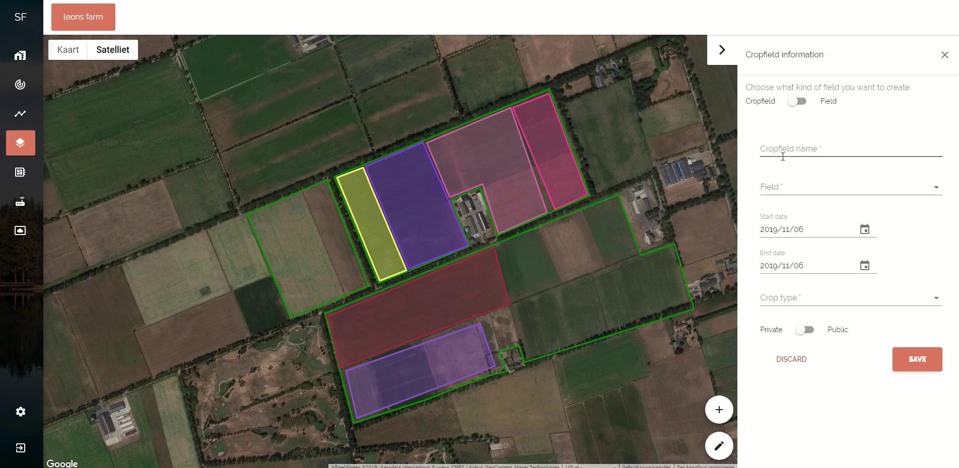
Notes:
Select fields view
Create 4 points
Fill in details for field
Save
Field is displayed
Create 4 points
Fill in details for cropfield
Save
Crop field is displayed
Crop details are displayed
Crop field information is edited
Page is reloaded
Data is imported
Then cancelled

Slide 20
Demo: Manage equipment
User can create datamap
User can create equipment model
User can create equipment

Slide 21
Notes:
Select equipment view
Select DataMap view
Show what a data map looks like
Add observations
Go back to equipment view
Create equipment
Fill in details for equipment
New equipment is created
Edit equipment details
Delete equipment
Confirm

Slide 22
Demo: Manage data
User can view live data
Our vision on the history view

Slide 23
Notes:
Select live view
Show two different crop fields
Select history view
Select one field
Show crop fields
Select second field
Show increase in crop fields
Select crop fields and crop types
Select sensor
Graphs show
Select extra crop field
More data shows

Slide 24
Demo: Manage user access
User can change roles of other users
User cannot remove their own admin status
User can have different roles on different farms

Slide 25
Notes:
Farm admin => farm settings
Add user to the farm
Change role
Can not change own role

